Slide 1
AI-Based Timetable Generation System aligned with NEP 2020 for Multidisciplinary Education Structures
CSE7101- Capstone Project
Review-1
Batch Number: COM_14
Under the Supervision of,
Ms.Babitha S
Assistant Professor
School of Computer Science and Engineering
Presidency University
Roll Number | Student Name
20221COM0019 | Makandar Saba Fareen
20221COM0039 | Billa Sunilkumar
20221COM0052 | Pikkili Sai Tarishma
Name of the Program: COM
Name of the HoD: Dr. Gopal Krishna Shyam
Name of the Program Project Coordinator: Ms. Sumita Guddin
Name of the School Project Coordinators: Dr. Sampath A K , Dr. Geetha A

Slide 2
Content
Problem Statement
Objectives
Background and Related work for title Selection
Analysis of Problem Statement
SDG Mapping
Innovation or Novel Contributions
Git-hub Link
Timeline of the Project
References

Slide 3
Problem Statement Number: 25091
Organization: Government of Jammu and Kashmir
Problem Description:
NEP 2020 introduces flexible, multidisciplinary, credit-based programs (FYUP, B.Ed., M.Ed.).
Students can choose multiple combinations of Major, Minor, and elective courses
Timetable preparation involves complex constraints like credits, faculty availability, and room capacity.
Manual scheduling is time-consuming and prone to conflicts and errors.
There is a need for an intelligent automated system to generate conflict-free timetables aligned with NEP 2020.

Slide 4
Objectives
To design an AI-assisted timetable generation system aligned with NEP 2020.
To automate the creation of conflict-free academic timetables for FYUP, B.Ed., M.Ed. programs.
To efficiently manage student elective choices, course credits, and multidisciplinary structures.
To optimize faculty workload distribution and classroom/lab utilization.
To provide flexibility for manual adjustments and future academic changes.

Slide 5
Background and Related Work
NEP 2020 introduces flexible, multidisciplinary, and credit-based higher education programs.
Most institutions still rely on manual or semi-automated timetable preparation methods.
Existing timetable systems are designed for fixed curricula and lack compatibility with NEP 2020.
Research indicates that constraint-based and optimization techniques can reduce scheduling conflicts.
Therefore, an AI-Based Timetable Generation System aligned with NEP 2020 is proposed to address these limitations.

Slide 6
Analysis of Problem Statement
NEP 2020 mandates flexible, multidisciplinary and credit-based academic structures.
Timetable generation must consider multiple dynamic constraints such as student electives, credit hours, and course categories.
Faculty availability, workload limits, and subject expertise add further complexity to scheduling.
Limited classroom and laboratory resources increase the possibility of clashes.
Manual or traditional systems are not scalable and fail to handle these constraints efficiently.
An automated and optimized approach is required to analyze constraints and generate conflict-free timetables.

Slide 7
Analysis of Problem Statement (contd...)
Software and Hardware Requirements:
Software:
Operating System: Windows / Linux
Frontend Technologies: HTML, CSS, JavaScript, React.js
Backend Technology: Python (FastAPI)
Scheduling Logic: AI-assisted constraint-based optimization
Development Tools: VS Code, Git
Web Browser: Google Chrome / Mozilla Firefox
Hardware:
Standard Computer or Laptop
Minimum 8 GB RAM

Slide 8
SDG Mapping
SDG 4 – Quality Education
Supports effective implementation of NEP 2020 through organized and conflict-free academic scheduling.
Enhances the quality of teaching and learning by ensuring well-structured academic timetables.
SDG 9 – Industry, Innovation and Infrastructure
Encourages the use of AI-assisted and digital solutions in academic administration.
Promotes innovation in institutional planning through software-based systems.
SDG 16 – Peace, Justice and Strong Institutions
Enables transparent and rule-based timetable generation, reducing manual bias.
Strengthens institutional efficiency and governance through automation.

Slide 9
Innovation / Novel Contribution:
Implements an AI-assisted constraint-based optimization approach for academic timetable generation.
Models NEP 2020 academic rules such as credit distribution, multidisciplinary electives, and theory–practical allocation.
Integrates multiple scheduling constraints including faculty availability, course requirements, and time-slot feasibility.
Provides automated conflict detection and resolution within the scheduling process.
Enables transparent and rule-based scheduling, improving institutional efficiency and consistency.

Slide 10
Github Link
The Github link provided should have public access permission.
Github Link
https://github.com/Tarishmapikkili/AI-Based-Timetable-Generation-System

Slide 11
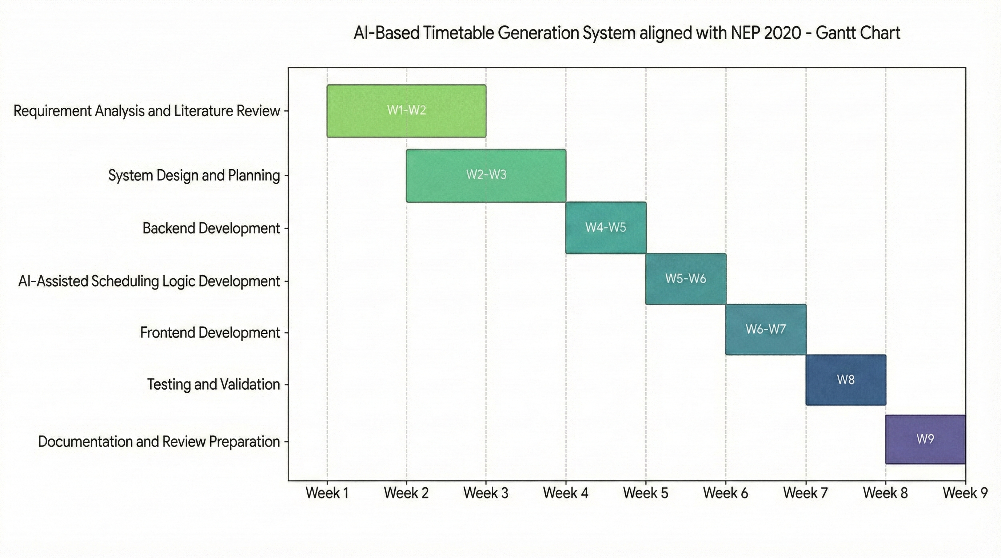
Timeline of the Project (Gantt Chart)

Slide 12
References (IEEE Paper format)
[1] N. R. Joshi and T. V. Agarwal, “Optimizing University Course Timetabling Using Constraint Satisfaction Models,” International Academic Journal of Science and Engineering, vol. 10, no. 4, pp. 5–8, Dec. 2023.
DOI: https://doi.org/10.71086/IAJSE/V10I4/IAJSE1032
[2] R. P. Badoni et al., “An Exploration and Exploitation-Based Metaheuristic Approach for University Course Timetabling Problems,” Axioms, vol. 12, no. 8, p. 720, Jul. 2023.
DOI: https://doi.org/10.3390/axioms12080720
[3] Wren, A. (1996). Scheduling, timetabling and rostering — A special relationship?. In: Burke, E., Ross, P. (eds) Practice and Theory of Automated Timetabling. PATAT 1995. Lecture Notes in Computer Science, vol 1153. Springer, Berlin, Heidelberg. https://doi.org/10.1007/3-540-61794-9_51

Slide 13
References (IEEE Paper format)
[4] V. Shah, A. Gadhvi, N. Oza, M. Sankhe, and M. Mangla, “Optimizing Timetable Generation for Educational Institute Using Genetic Algorithm,” in Proceedings of the International Conference on Recent Advances in Sustainable Intelligent Technology Applications (RAMSITA 2025), 2025.
DOI: https://doi.org/10.2991/978-94-6463-716-8_37
[5] “A Survey Paper on Timetable Generator Using AI Methods,” International Research Journal of Advanced Engineering Hub, vol. 3, no. 03, pp. 860–864, Mar. 2025.
DOI: https://doi.org/10.47392/IRJAEH.2025.0122
[6] X. Han and D. Wang, “Gradual Optimization of University Course Scheduling Problem Using Genetic Algorithm and Dynamic Programming,” Algorithms, vol. 18, no. 3, p. 158, 2025.
DOI: https://doi.org/10.3390/a18030158

Slide 14
References (IEEE Paper format)
[7] Z. Bratković, T. Herman, V. Omrčen, M. Čupić, and D. Jakobović, “University Course Timetabling with Genetic Algorithm: A Laboratory Exercises Case Study,” in Evolutionary Computation in Combinatorial Optimization (EvoCOP 2009), Lecture Notes in Computer Science, vol. 5482. Springer, 2009.
DOI: https://doi.org/10.1007/978-3-642-01009-5_21
[8]A. Muklason, A. Marom, and I. G. A. Premananda, “Automated Course Timetabling Optimization Using Tabu-Simulated Annealing Hyper-Heuristics Algorithm,” Khazanah Informatika: Jurnal Ilmu Komputer dan Informatika, vol. 10, no. 1, 2024.
DOI : https://doi.org/10.23917/khif.v10i1.4835
[9] A. R. Mahlous and H. Mahlous, “Student Timetabling Genetic Algorithm Accounting for Student Preferences,” PeerJ Computer Science, vol. 9, p. e1200, Feb. 2023.
DOI: https://doi.org/10.7717/peerj-cs.1200

Slide 15


